Slide 1
GEOG-G489/589 Advanced Geospatial Data Analysis in Python
Instructor: Natasha MacBean
Introduction to Matplotlib (and a bit more on NumPy)

Slide 2
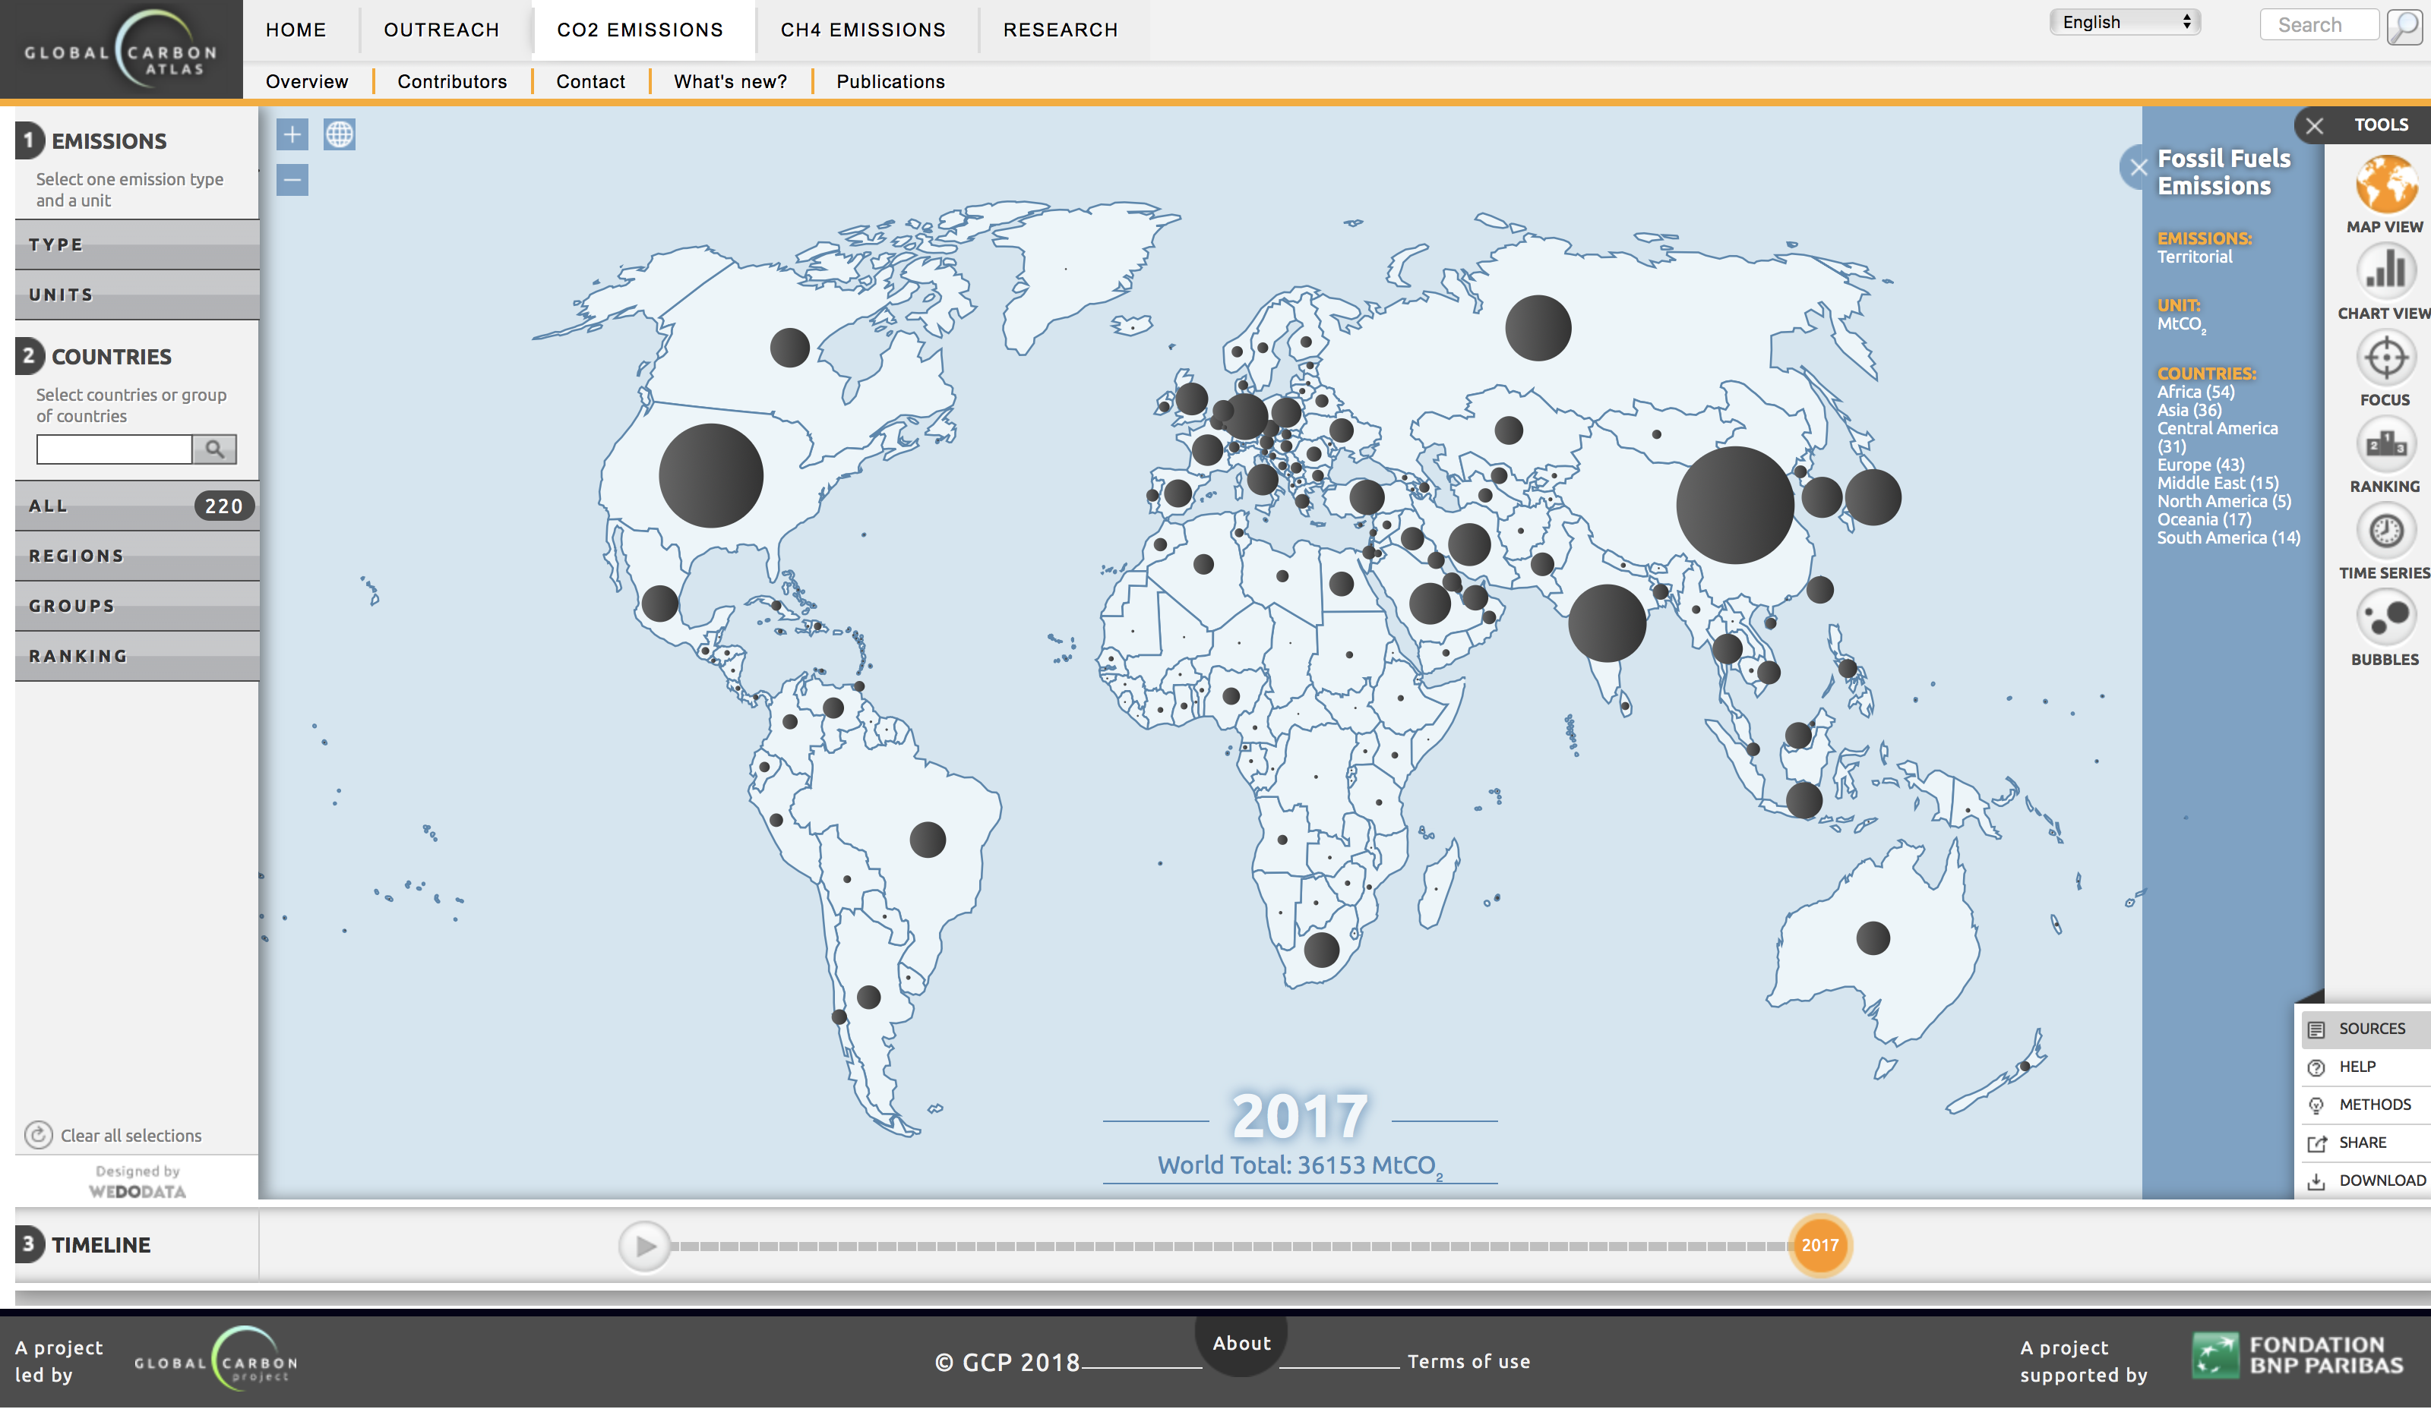
Today’s data: global CO₂ emissions
http://globalcarbonatlas.org/en/CO2-emissions

Slide 3
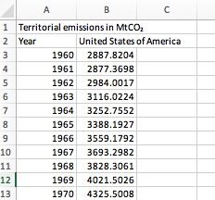
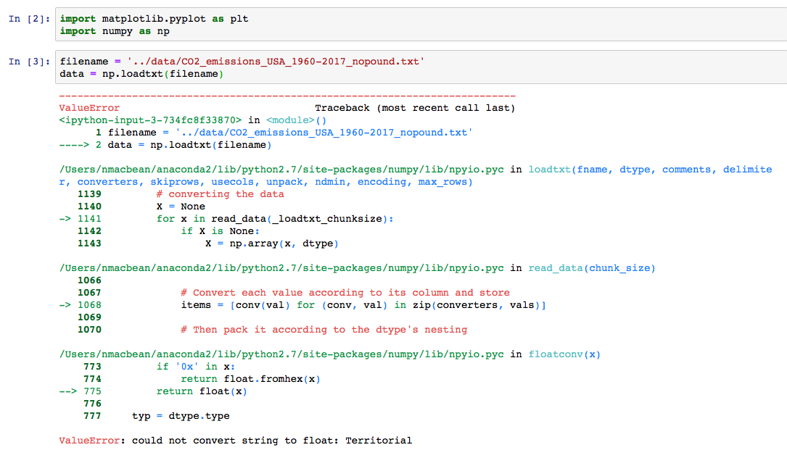
NumPy loadtxt with and without string headings…

Slide 4
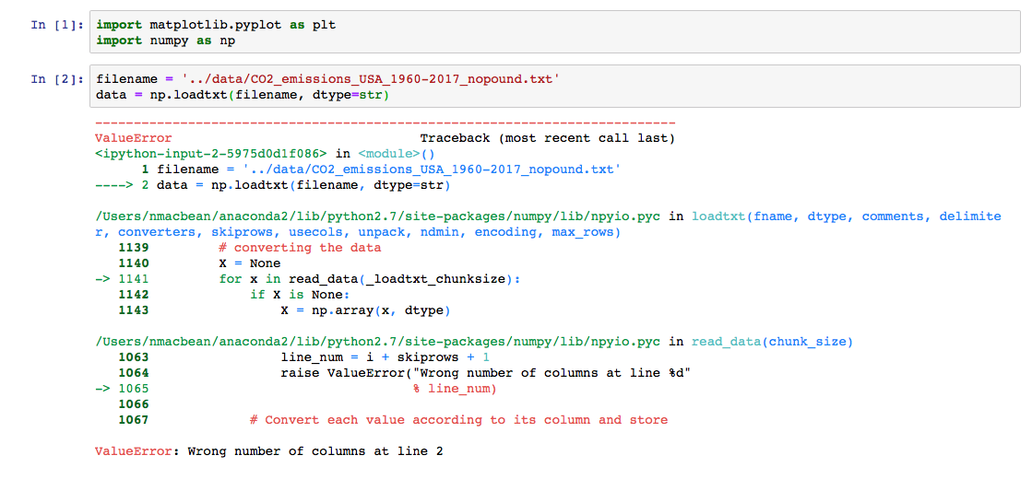
NumPy loadtxt with and without string headings…

Slide 5
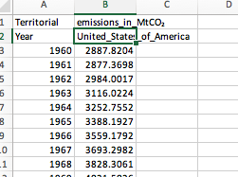
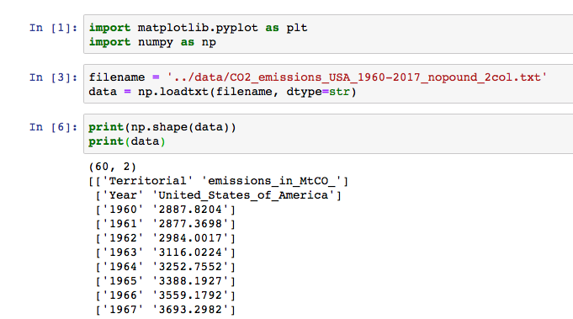
NumPy loadtxt with and without string headings…

Slide 6
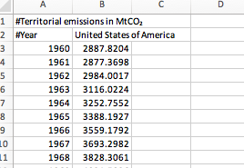
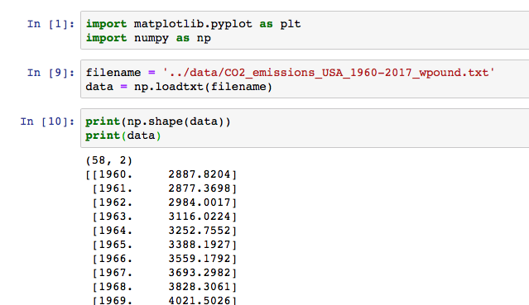
NumPy loadtxt with and without string headings…

Slide 7
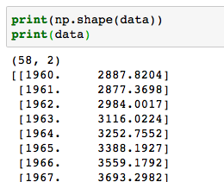
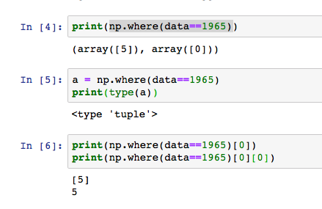
Indexing (finding rows and columns) using np.where() and np.argwhere()

Slide 8
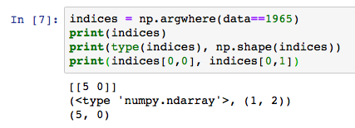
Indexing using np.where() and np.argwhere()

Slide 9
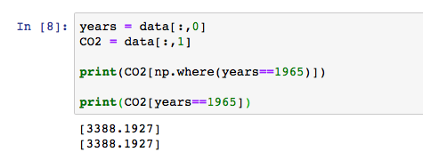
Indexing using np.where() and np.argwhere()

Slide 10
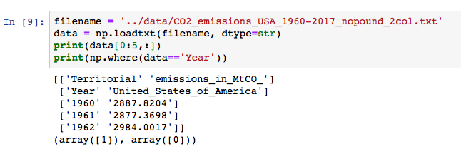
Indexing using np.where() and np.argwhere()

Slide 11
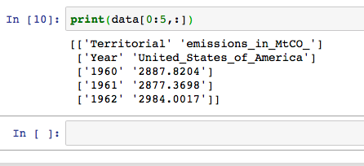
Back to slicing…

Slide 12
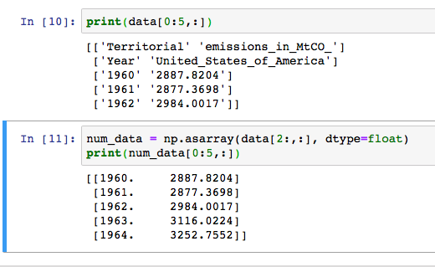
Slicing and np.asarray(X, dtype=str,int,float)

Slide 13
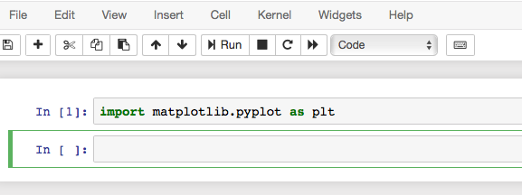
Matplotlib
Plotting library for Python → use for data visualization and exploratory analysis.
We use Matplotlib’s pyplot module for all the basic plotting functions.
A module is a file/script with python code (usually grouping similar and specific functions).
Matplotlib is powerful – but can be finicky!

Slide 14
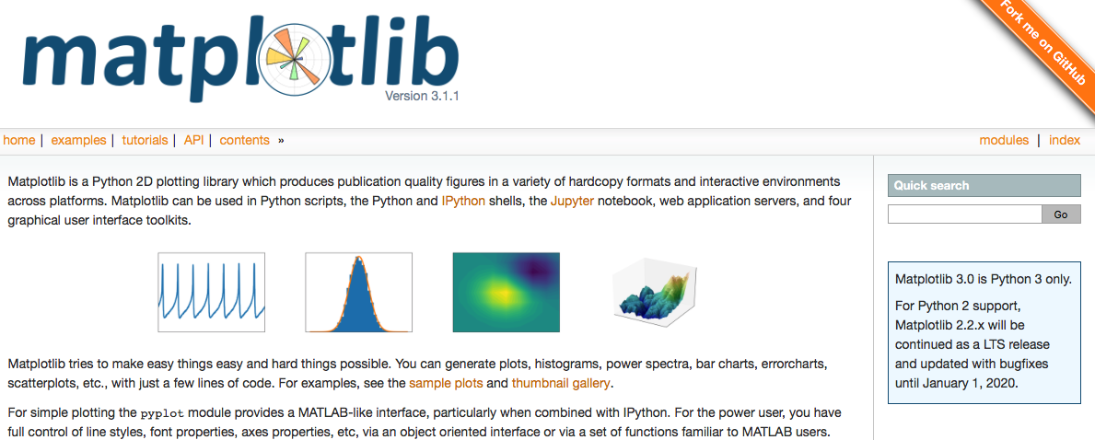
Matplotlib
https://matplotlib.org/
Make good use of example gallery and tutorials page!

Slide 15
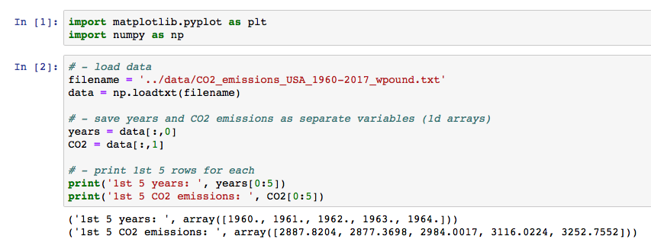
Matplotlib

Slide 16
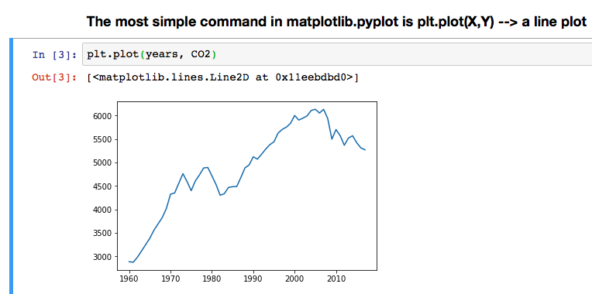
Matplotlib – plt.plot()

Slide 17
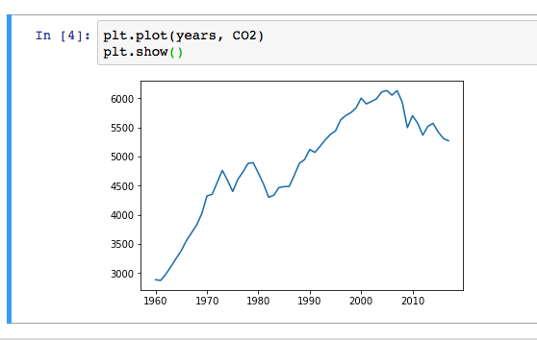
Matplotlib – plt.plot()

Slide 18
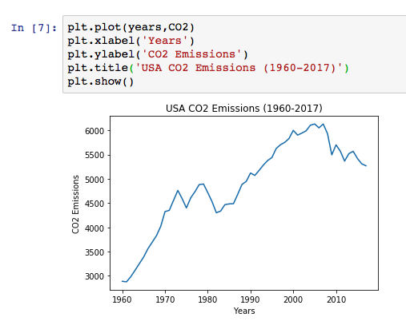
Matplotlib – adding axis labels and titles

Slide 19
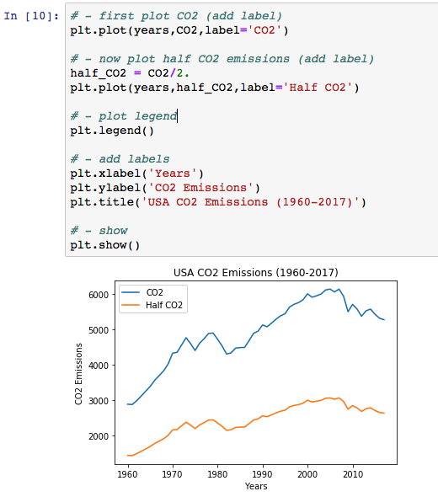
Matplotlib – plotting multiple lines and adding labels and a legend

Slide 20
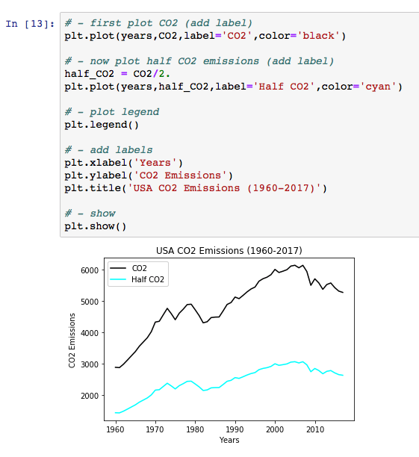
Matplotlib – changing the color of your lines

Slide 21
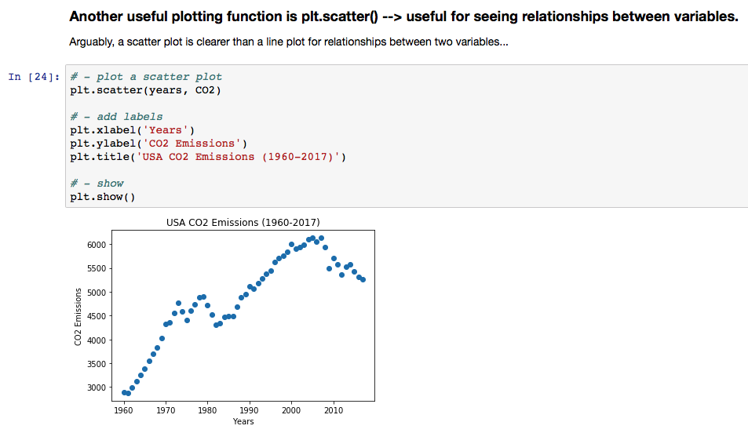
Matplotlib – plt.scatter()

Slide 22
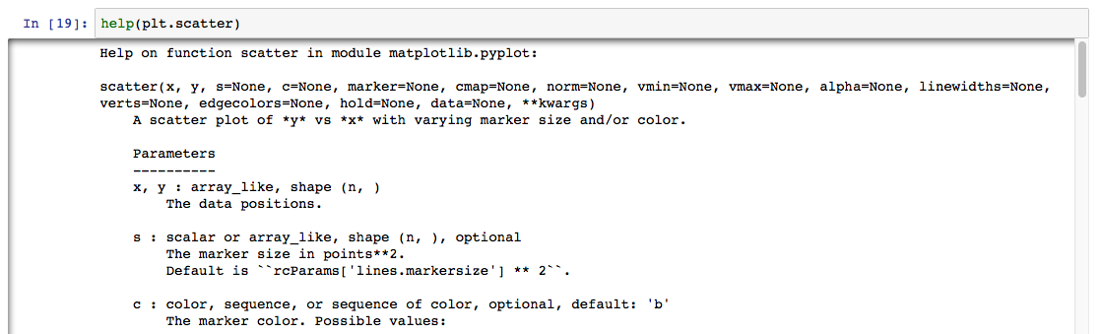
Matplotlib – using the help() function to see the arguments of a function

Slide 23
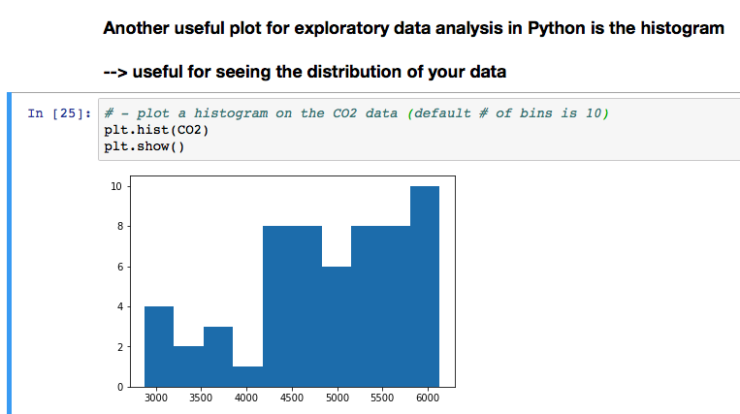
Matplotlib – plt.hist()

Slide 24
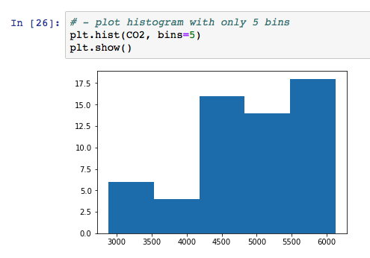
Matplotlib – plt.hist()

Slide 25
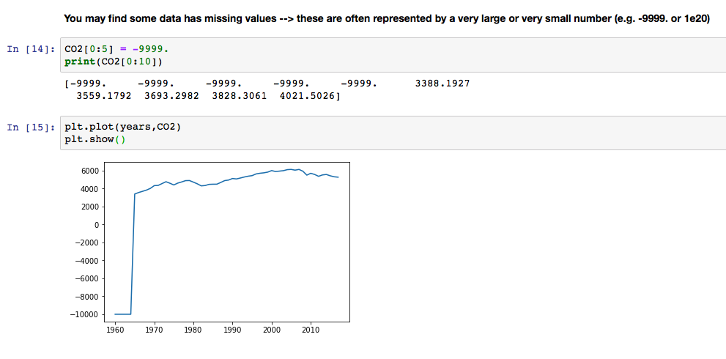
Matplotlib – quickly dealing with missing values when plotting

Slide 26
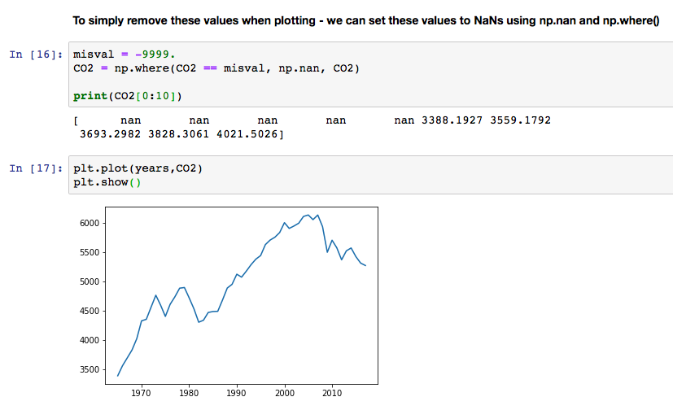
Matplotlib – quickly dealing with missing values when plotting

Slide 27
Today’s in-class exercise
First, download data.tar and untar it in your C:\username\Downloads\ folder.
From the data folder, load a file called “CO2_emissions_Americas_1960-2017_nopound.txt”
Use slicing and indexing to separate out the country names (headers) from the 1st row
Use slicing and indexing to separate out the years
Use slicing and indexing to separate out the CO2 data for all countries across the Americas.
Explore your data! E.g:
Print out the array that contains your country names to see which countries are there and how they are spelt etc.
Print the first 10-20 rows of the CO2 data for your chosen countries to see if there are any missing data – if so, set them to np.nan.
Plot the 1960 – 2017 time series of CO2 emissions for 1 North American country, 1 Central American country and one South American country on the same plot with a legend! Change colors if you would like…
→ How will you find the column index for each country?
Give the plot axis labels and a title.
Don’t forget to use comments for each separate bit of code!

Slide 28
Today’s in-class exercise - EXTRA
EXTRA if you’re familiar with python or if you’re finding this too easy!
Google pyplot.bar() to see how to plot a bar plot in Matplotlib
Plot a bar plot for the 2017 (last year in the file) CO2 emissions of the first 10 countries in the file.
Change the xtick labels to the 10 country names.
Give the plot axis labels and a title.
Question: which country from the list of the 1st 10 countries had the highest CO2 emissions in 2017?

